Slide 1
Ordered Outcomes

Slide 2
MLE Recap
A maximum likelihood estimate is that value of the population parameter (Θ) that makes the observed data most probable.
MLE requires correctly specified
  Model
  Link function (estimator) to map the linear predictor (Xβ) onto non-linear distribution of y
  Variance function determined by dispersion of y
MLE requires us to estimate joint probabilities of observing the entire dataset using the cdf (cumulative distribution function)
  cdf refers to the probability a variable (here, y) is equal or less some value
  not just the likelihood of observing a single observation using the pdf, as in OLS

Slide 3
Motivating the Binary Choice Model
Do you consider yourself a Democrat, Republican or an Independent? y_{i} = 0 Republican, 1 Democrat
  Consider y_{i} crude reflection of an underlying/latent continuum that captures w/infinite precision, how Democratic a person feels
  Call it y_{i}* and model it a f of systematic & stochastic components
  y_{i}* = α + x_{i}β + ε_{i}
  ε_{i} captures unobserved factors that make individual feel +/- Democratic
  x_{i} is a set of observed predictors y_{i}* (e.g., race, income) that influence how Democratic ones feels.

Slide 4
Review: Theory for Modeling Binary Outcome
y_{i}* as the relative probability of choosing option, i.e. 0 v. 1
Identify a “cut point” at which choice flips (e.g. > 0.5)
Interpret by focusing on how variables affect that probability/odds of a choice
Choose variance function/error distribution to estimate
  Logistic (for logit)
  Normal (for probit)

Slide 5
Examples of Ordered Variables
Most survey questions
  Government approval
  Satisfaction questions
Freedom House scores/Polity scores/corruption measures
Type of conflict (possibly)
Human rights data
Etc.

Slide 6
Motivating the Ordered Choice Model
Do you consider yourself a Democrat, Republican or an Independent? y_{i} = 1 Republican, 2 Independent, 3 Democrat
  Consider y_{i} crude reflection of an underlying/latent continuum that captures w/infinite precision, how Democratic a person feels
  Call it y_{i}* and model it a f of systematic & stochastic components
  y_{i}* = X_{i}β + ε_{i} (no constant)
  ε_{i} captures unobserved factors that make individual feel +/- Democratic
  X_{i} is a set of observed predictors y_{i}* (e.g., race, income) that influence how Democratic ones feels.

Slide 7
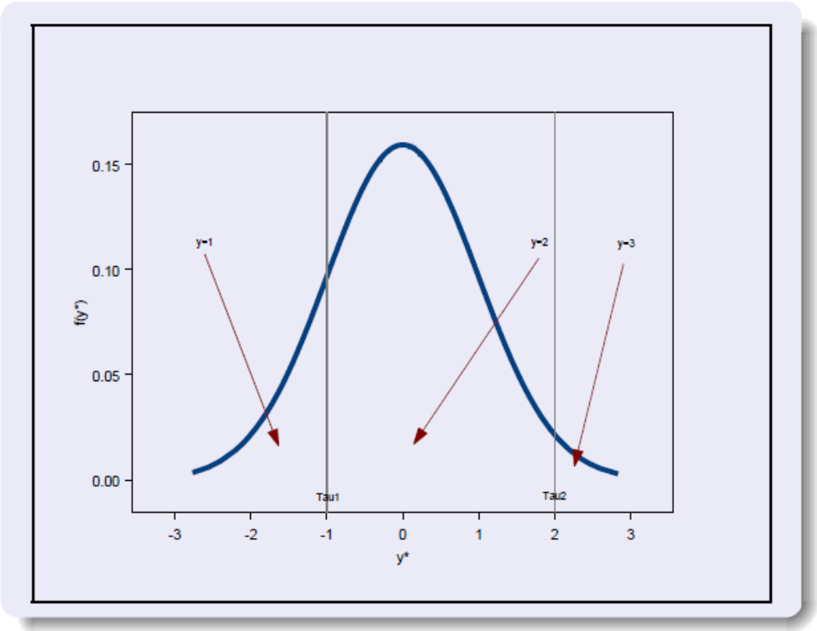
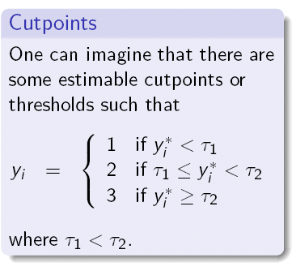
Cutpoints

Slide 8
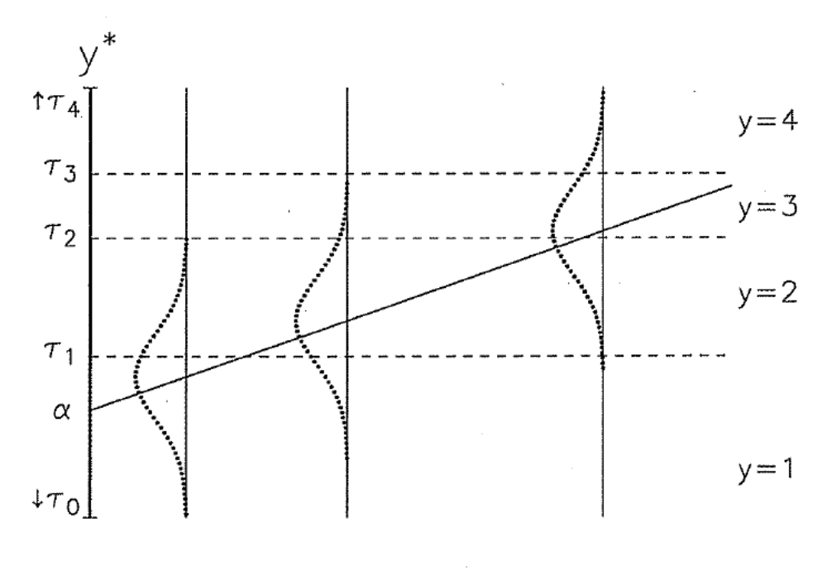
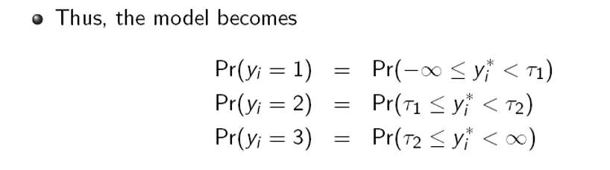
Cutpoints

Slide 9
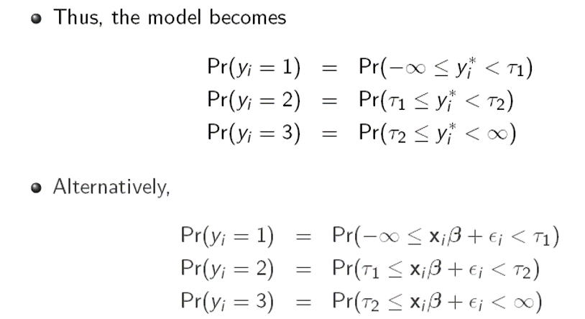
Cutpoints

Slide 10
The (non) constant
Ordered logit usually does not estimate a constant b/c of lack of degrees of freedom introduced by the cutpoints.
  Sometimes, though, it constrains the first cutpoint to 0
In logit, the constant is how easy/hard is it to start moving towards the 0.50 cutoff
In ordered models, we move the cutpoints down/up if it is easy/hard to have an outcome occur

Slide 11
What is the probability of outcome m?
The probability of outcome m corresponds to the area of the error distribution between the cutpoints

Slide 12
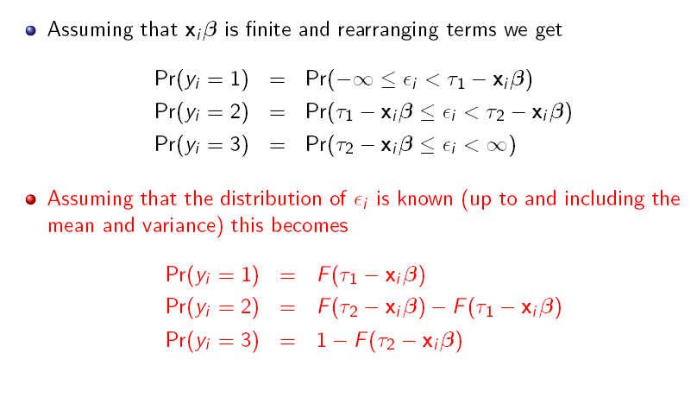
Choice of a particular category is probabilistic due to the stochastic component ε_{i} in y_{i}*

Slide 13
The (hopefully familiar sounding) Process of Estimating Ordered Models
y_{i}* is the relative probability of choosing each successive option 1 v. 2, 2 v. 3, m v. m+1
  In other words, binary models are just a form of ordered models
Estimate a series of “cut points” at which choice of one > choice of the other
Interpret by focusing on how variables affect the probability/odds of each choice
Choose variance function/error distribution to estimate
  Logistic (for logit)
  Normal (for probit)

Slide 14
Comparisons of the regular and ordered logit for binary DVs
logit pres_app economy_better party
Logistic regression Number of obs = 1017
LR chi2(2) = 587.73
Prob > chi2 = 0.0000
Log likelihood = -405.63736 Pseudo R2 = 0.4201
------------------------------------------------------------------------------
pres_app | Coef. Std. Err. z P>|z| [95% Conf. Interval]
-------------+----------------------------------------------------------------
economy_be~r | 1.033248 .1316744 7.85 0.000 .7751711 1.291325
party | -1.056931 .0618955 -17.08 0.000 -1.178244 -.9356183
_cons | 2.213561 .2190052 10.11 0.000 1.784319 2.642803
------------------------------------------------------------------------------
ologit pres_app economy_better party
Ordered logistic regression Number of obs = 1017
LR chi2(2) = 587.73
Prob > chi2 = 0.0000
Log likelihood = -405.63736 Pseudo R2 = 0.4201
------------------------------------------------------------------------------
pres_app | Coef. Std. Err. z P>|z| [95% Conf. Interval]
-------------+----------------------------------------------------------------
economy_be~r | 1.033248 .1316744 7.85 0.000 .7751711 1.291325
party | -1.056931 .0618955 -17.08 0.000 -1.178244 -.9356183
-------------+----------------------------------------------------------------
/cut1 | -2.213561 .2190052 -2.642803 -1.784319
------------------------------------------------------------------------------
.

Slide 15
Predicted probabilities
Logit: pr(Y|A)=1/(1+exp(-A))

Slide 16
Predicted probabilities
Logit: pr(Y|A)=1/(1+exp(-A))
Pr (y=1)=1/(1+exp(Xβ-τ₁))
  Note that I just flipped around the “–A”

Slide 17
Predicted probabilities
Logit: pr(Y|A)=1/(1+exp(-A))
Pr (y=1)=1/(1+exp(Xβ-τ₁))
Pr (y=2)= 1/(1+exp(Xβ-τ₂)) -1/(1+exp(Xβ-τ₁))
Pr(y=3)=1- 1/(1+exp(Xβ-τ₂))

Slide 18
Predicted probabilities
Logit: pr(Y|A)=1/(1+exp(-A))
Pr (y=1)=1/(1+exp(Xβ-τ₁))
Pr (y=2)= 1/(1+exp(Xβ-τ₂)) -1/(1+exp(Xβ-τ₁))
Pr(y=3)=1- 1/(1+exp(Xβ-τ₂))
What would be the PR (Y>2)?

Slide 19
Predicted probabilities
Logit: pr(Y|A)=1/(1+exp(-A))
Pr (y=1)=1/(1+exp(Xβ-τ₁))
Pr (y=2)= 1/(1+exp(Xβ-τ₂)) -1/(1+exp(Xβ-τ₁))
Pr(y=3)=1- 1/(1+exp(Xβ-τ₂))
What would be the equations for a 4-category variable?

Slide 20
Key point for the intuition
Technically solves M-1 separate models:
  What distinguishes Y=2 from y=1
  What distinguishes Y=3 from Y=2
  Etc.
Pools all those results into a single model by assuming that the slopes are constant but the cut-points differ
  Call that the parallel regression assumption

Slide 21
Estimating the model
Have to make an assumption about how errors are distributed
  Continuous normal distribution: probit
  Continuous logistic distribution: logit
Ordered logit and ordered probit
  ologit
  oprobit
Most of what we said last week still applies
  Can’t interpret coefficients directly
  Focus on predicted probabilities
  Clarify and Spost still work (generally) the same

Slide 22
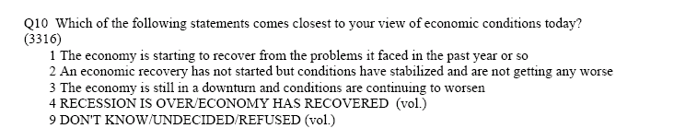
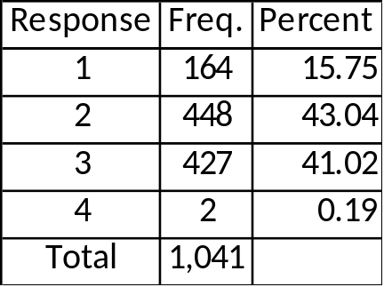
Example from the same CNN data we all love so much…
Ordered models are less likely to converge if there are empty cells or nearly empty cells (especially top cells that can be predicted perfectly)
Will also have estimates that are less reliable
I thus recode category 4 with category 1 and then flip its scale

Slide 23
Hypothesis to test
Is there a relationship between partisanship and evaluations of the economy?
Conover, Feldman, and Knight (1986, 1987), Wlezien, Franklin, and Twiggs (1997), Evans and Andersen (2001), van der Brug et al (2007),
Of course, macropartisanship changes in response to economic fluctuations (Erickson et al 2002), so causality is hard…

Slide 24
For your information
gen economy_better=q10*-1+3 if q10<=3
replace economy_better=2 if q10==4
/*note this rescaling was my choice because I didn’t want there to be influential observations */
gen liberal_ideology=d8-1 if d8<=5
gen age_d3=d3-1 if d3<=20
/* I am letting age be a continuous variable here */
gen female=sex-1
replace race=4 if race>=4 & race~=.
replace race=. if d5_1==9
/*I am recoding it so that it is 1=White, 2=Black, 3=Hispanic, and 4=Other Race, remember race must be broken into dummy variables */
gen education=d1-1 if d1<=8
gen income_d6=d6a-1 if d6a<=5
replace income_=d6b+4 if d6b<=5

Slide 25
Interpret the signs and significance:
Hiding iterations/N/R2
. ologit economy_better female age_d3 education income_d6 i.race party, nohead nolog
--------------------------------------------------------------------------------
economy_better | Coef. Std. Err. z P>|z| [95% Conf. Interval]
---------------+----------------------------------------------------------------
female | -.1559337 .1320292 -1.18 0.238 -.4147062 .1028388
age_d3 | .0092311 .02206 0.42 0.676 -.0340057 .0524678
education | .1096631 .0467115 2.35 0.019 .0181102 .201216
income_d6 | .0420399 .0249484 1.69 0.092 -.0068581 .0909379
|
race |
2 | .3031605 .3021777 1.00 0.316 -.289097 .895418
3 | .3377154 .3048791 1.11 0.268 -.2598366 .9352674
4 | -.1192287 .264356 -0.45 0.652 -.6373569 .3988995
|
party | -.3462757 .0419618 -8.25 0.000 -.4285193 -.2640322
---------------+----------------------------------------------------------------
/cut1 | -.8468273 .2941817 -1.423413 -.2702417
/cut2 | 1.384699 .2979581 .8007119 1.968686
--------------------------------------------------------------------------------

Slide 26
Calculate predicted probs by party for white male (modal category) at other variables’ average
By hand (took me about 5 minutes)
 | Pr(Economy Worse) | Pr(Economy Stable) | Pr(Economy Improving)
Party=1 (Democrat) | 0.238 | 0.506 | 0.256
Party=2 (Dem Leaner) | 0.306 | 0.498 | 0.196
Party=3 (Independent) | 0.384 | 0.469 | 0.147
Party=4 (Rep Leaner) | 0.469 | 0.423 | 0.109
Party=5 (Republican) | 0.555 | 0.366 | 0.079

Slide 27
Calculate predicted probs by party for white male (modal category) at other variables’ average
Spost
. mtable, at(party=(1 2 3 4 5) race==1 female==0) atmeans
Expression: Pr(economy_better), predict(outcome())
| party 0 1 2
----------+---------------------------------------
1 | 1 0.238 0.506 0.255
2 | 2 0.307 0.498 0.195
3 | 3 0.385 0.469 0.146
4 | 4 0.469 0.422 0.108
5 | 5 0.556 0.365 0.079
Specified values of covariates
| female age_d3 education income_d6 race
----------+---------------------------------------------------
Current | 0 7.62 3.63 4.59 1
I like having the variables here to check I got the code right

Slide 28
Calculate predicted probs by party for white male (modal category) at other variables’ average
Spost
. mtable, over(party) atmeans at(race==1 female==0)
Expression: Pr(economy_better), predict(outcome())
| age_d3 education income_d6 party 0 1 2
----------+-----------------------------------------------------------------------
1 | 7.79 3.57 4.16 1 0.243 0.506 0.251
2 | 7.22 3.74 4.56 2 0.305 0.498 0.196
3 | 7.13 3.25 3.83 3 0.403 0.460 0.137
4 | 7.37 3.75 4.92 4 0.463 0.426 0.111
5 | 7.94 3.64 4.98 5 0.551 0.369 0.081
Specified values of covariates
| female race
----------+-------------------
Current | 0 1
Here it did the mean for each category of party while holding the two demographic variables constant (the 0, 1, 2 columns are the probs)

Slide 29
Calculate predicted probs by party for white male (modal category) at other variables’ average
Spost
. mtable, over(party) atmeans at(race==1 female==0)
Expression: Pr(economy_better), predict(outcome())
| age_d3 education income_d6 party 0 1 2
----------+-----------------------------------------------------------------------
1 | 7.79 3.57 4.16 1 0.243 0.506 0.251
2 | 7.22 3.74 4.56 2 0.305 0.498 0.196
3 | 7.13 3.25 3.83 3 0.403 0.460 0.137
4 | 7.37 3.75 4.92 4 0.463 0.426 0.111
5 | 7.94 3.64 4.98 5 0.551 0.369 0.081
Specified values of covariates
| female race
----------+-------------------
Current | 0 1
Here it did the mean for each category of party while holding the two demographic variables constant (the 0, 1, 2 columns are the probs)

Slide 30
quietly ologit economy_better female age_d3 education income_d6 i.race party, nohead nolog
. mgen, at(party=(1(1)5) race=1 female=0) atmeans stub(ex_)
Predictions from: margins, at(party=(1(1)5) race=1 female=0) atmeans predict(outcome())
Variable Obs Unique Mean Min Max Label
-----------------------------------------------------------------------------------------------------------------------------------------
ex_pr0 5 5 .390986 .238371 .5556366 pr(y=0) from margins
ex_ll0 5 5 .3398654 .1877691 .4970731 95% lower limit
ex_ul0 5 5 .4421065 .2889729 .6142001 95% upper limit
ex_party 5 5 3 1 5 party
ex_Cpr0 5 5 .390986 .238371 .5556366 pr(y<=0)
ex_pr1 5 5 .4521149 .3652896 .5062059 pr(y=1) from margins
ex_ll1 5 5 .4122717 .3201604 .4686367 95% lower limit
ex_ul1 5 5 .4919582 .4104187 .5437752 95% upper limit
ex_Cpr1 5 5 .8431009 .7445769 .9209262 pr(y<=1)
ex_pr2 5 5 .1568991 .0790738 .255423 pr(y=2) from margins
ex_ll2 5 5 .1234724 .0574913 .2024363 95% lower limit
ex_ul2 5 5 .1903258 .1006563 .3084098 95% upper limit
ex_Cpr2 5 2 1 .9999999 1 pr(y<=2)
-----------------------------------------------------------------------------------------------------------------------------------------
Specified values of covariates
female age_d3 education income_d6 race
------------------------------------------------------
0 7.619209 3.628249 4.587571 1

Slide 31
quietly ologit economy_better female age_d3 education income_d6 i.race party, nohead nolog
. mgen, at(party=(1(1)5) race=1 female=0) atmeans stub(ex_)
Predictions from: margins, at(party=(1(1)5) race=1 female=0) atmeans predict(outcome())
Variable Obs Unique Mean Min Max Label
-----------------------------------------------------------------------------------------------------------------------------------------
ex_pr0 5 5 .390986 .238371 .5556366 pr(y=0) from margins
ex_ll0 5 5 .3398654 .1877691 .4970731 95% lower limit
ex_ul0 5 5 .4421065 .2889729 .6142001 95% upper limit
ex_party 5 5 3 1 5 party
ex_Cpr0 5 5 .390986 .238371 .5556366 pr(y<=0)
ex_pr1 5 5 .4521149 .3652896 .5062059 pr(y=1) from margins
ex_ll1 5 5 .4122717 .3201604 .4686367 95% lower limit
ex_ul1 5 5 .4919582 .4104187 .5437752 95% upper limit
ex_Cpr1 5 5 .8431009 .7445769 .9209262 pr(y<=1)
ex_pr2 5 5 .1568991 .0790738 .255423 pr(y=2) from margins
ex_ll2 5 5 .1234724 .0574913 .2024363 95% lower limit
ex_ul2 5 5 .1903258 .1006563 .3084098 95% upper limit
ex_Cpr2 5 2 1 .9999999 1 pr(y<=2)
-----------------------------------------------------------------------------------------------------------------------------------------
Specified values of covariates
female age_d3 education income_d6 race
------------------------------------------------------
0 7.619209 3.628249 4.587571 1
This lists new variables it generated to save the parameters

Slide 32
I did slightly more complicated code than the example on page 361 because I wanted the CI’s and needed to control the colors and wanted labels for the x axis
twoway (connected ex_pr0 ex_party, msymbol(none) lcolor(red) lpattern(solid)) (connected ex_ll0 ex_party, msymbol(none) lcolor(red) lpattern(dash)) (connected ex_ul0 ex_party, msymbol(none) lcolor(red) lpattern(dash)) (connected ex_pr1 ex_party, msymbol(none) lcolor(blue) lpattern(solid)) (connected ex_ll1 ex_party, msymbol(none) lcolor(blue) lpattern(dash)) (connected ex_ul1 ex_party, msymbol(none) lcolor(blue) lpattern(dash)) (connected ex_pr2 ex_party, msymbol(none) lcolor(green) lpattern(solid)) (connected ex_ll2 ex_party, msymbol(none) lcolor(green) lpattern(dash)) (connected ex_ul2 ex_party, msymbol(none) lcolor(green) lpattern(dash)), xtitle("Party Identification") xlabel( 1 "Democrat" 2 "Ind-Dem" 3 "Independent" 4 "Ind-Rep." 5 "Republican")

Slide 33
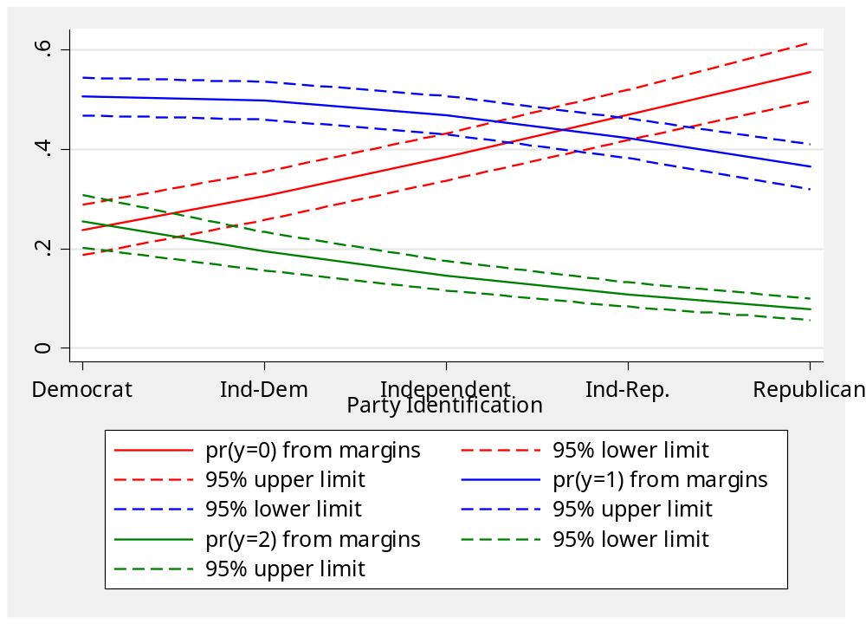
I would format the legend better if publishing

Slide 34
To do in black and white, change the markers
twoway (connected ex_pr0 ex_party, mcolor(black) msymbol(circle) lcolor(black) lpattern(solid)) (connected ex_ll0 ex_party, msymbol(none) lcolor(black) lpattern(dash)) (connected ex_ul0 ex_party, msymbol(none) lcolor(black) lpattern(dash)) (connected ex_pr1 ex_party, mcolor(black) msymbol(diamond) lcolor(black) lpattern(solid)) (connected ex_ll1 ex_party, msymbol(none) lcolor(black) lpattern(dash)) (connected ex_ul1 ex_party, msymbol(none) lcolor(black) lpattern(dash)) (connected ex_pr2 ex_party, mcolor(black) msymbol(triangle) lcolor(black) lpattern(solid)) (connected ex_ll2 ex_party, msymbol(none) lcolor(black) lpattern(dash)) (connected ex_ul2 ex_party, msymbol(none) lcolor(black) lpattern(dash)), xtitle("Party Identification") xlabel( 1 "Democrat" 2 "Ind-Dem" 3 "Independent" 4 "Ind-Rep." 5 "Republican")

Slide 35
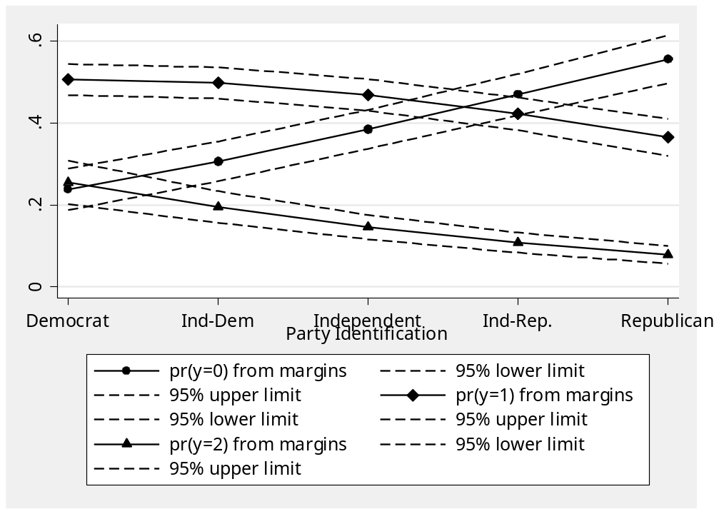
(still need to clean up the legend)

Slide 36
Clarify (doing party=1 and party=5 as examples)
. quietly xi: estsimp ologit economy_better female age_d3 education income_d6 i.race party, genname(newvar)
. setx mean
. setx female 0 _Irace_2 0 _Irace_3 0 _Irace_4 0
. setx party 1
. simqi
Quantity of Interest | Mean Std. Err. [95% Conf. Interval]
---------------------------+--------------------------------------------------
Pr(econom~r=0) | .2393009 .0258788 .1879972 .2943669
Pr(econom~r=1) | .5038667 .0187969 .4668953 .5395305
Pr(econom~r=2) | .2568324 .027625 .2067909 .3138334
. setx party 5
. simqi
Quantity of Interest | Mean Std. Err. [95% Conf. Interval]
---------------------------+--------------------------------------------------
Pr(econom~r=0) | .5550237 .0300665 .4941125 .614594
Pr(econom~r=1) | .364926 .0229298 .3183482 .4112869
Pr(econom~r=2) | .0800503 .0111094 .0605658 .1043212

Slide 37
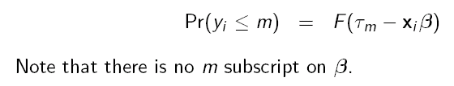
First of 2 Necessary Assumptions
Assume that slopes are constant across models
If we graph the cumulative choice curves, we obtain parallel curves, whence the name parallel regression assumption.

Slide 38
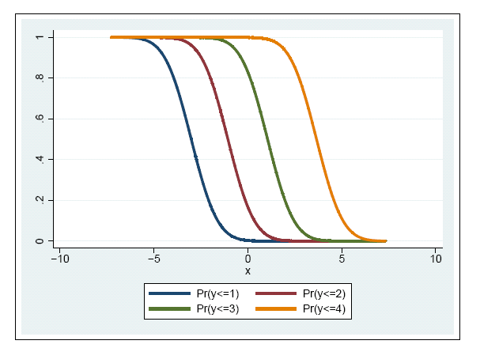

Slide 39
First of 2 Necessary Assumptions
This assumption is frequently violated
Multiple ways to test
Easiest: Estimate a binary logit model for each pair of sequential outcomes and compare slopes
Called the Brant test
Spost can do it for you…

Slide 40
. quietly xi: ologit economy_better female age_d3 education income_d6 i.race party
. brant
Brant test of parallel regression assumption
| chi2 p>chi2 df
-------------+------------------------------
All | 8.12 0.422 8
-------------+------------------------------
female | 0.44 0.505 1
age_d3 | 1.32 0.250 1
education | 0.35 0.556 1
income_d6 | 1.03 0.310 1
_Irace_2 | 0.44 0.507 1
_Irace_3 | 2.65 0.103 1
_Irace_4 | 0.33 0.566 1
party | 0.10 0.756 1
A significant test statistic provides evidence that the parallel
regression assumption has been violated.

Slide 41
. quietly xi: ologit economy_better female age_d3 education income_d6 i.race party
. brant
Brant test of parallel regression assumption
| chi2 p>chi2 df
-------------+------------------------------
All | 8.12 0.422 8
-------------+------------------------------
female | 0.44 0.505 1
age_d3 | 1.32 0.250 1
education | 0.35 0.556 1
income_d6 | 1.03 0.310 1
_Irace_2 | 0.44 0.507 1
_Irace_3 | 2.65 0.103 1
_Irace_4 | 0.33 0.566 1
party | 0.10 0.756 1
A significant test statistic provides evidence that the parallel
regression assumption has been violated.
No significant tests, means that the this model actually does not violate the assumption!

Slide 42
. brant, detail
Estimated coefficients from binary logits
------------------------------------
Variable | y_gt_0 y_gt_1
-------------+----------------------
female | -0.122 -0.258
| -0.84 -1.32
age_d3 | -0.006 0.033
| -0.27 1.00
education | 0.126 0.084
| 2.47 1.26
income_d6 | 0.055 0.017
| 2.03 0.47
_Irace_2 | 0.441 0.139
| 1.17 0.35
_Irace_3 | 0.648 -0.275
| 1.70 -0.54
_Irace_4 | -0.106 -0.358
| -0.37 -0.84
party | -0.347 -0.367
| -7.47 -5.83
_cons | 0.821 -1.188
| 2.57 -2.77
------------------------------------
legend: b/t
Is because a lot of the variables have large standard errors that overlap (look at race=3 for example)
Some variables are only significant for some portions of the analysis
Party meets the assumption really well…

Slide 43
Example : Proportional Odds Assumption Violated
I stole this form http://www.nd.edu/~rwilliam/
(He Adapted from Long & Freese, 2003 – Data from the 1977 & 1989 General Social Survey)
Respondents are asked to evaluate the following statement: “A working mother can establish just as warm and secure a relationship with her child as a mother who does not work.”
  1 = Strongly Disagree (SD)
  2 = Disagree (D)
  3 = Agree (A)
  4 = Strongly Agree (SA).

Slide 44
Explanatory variables are
  yr89 (survey year; 0 = 1977, 1 = 1989)
  male (0 = female, 1 = male)
  white (0 = nonwhite, 1 = white)
  age (measured in years)
  ed (years of education)
  prst (occupational prestige scale).

Slide 45
Ologit results
. ologit warm yr89 male white age ed prst
Ordered logit estimates Number of obs = 2293
LR chi2(6) = 301.72
Prob > chi2 = 0.0000
Log likelihood = -2844.9123 Pseudo R2 = 0.0504
------------------------------------------------------------------------------
warm | Coef. Std. Err. z P>|z| [95% Conf. Interval]
-------------+----------------------------------------------------------------
yr89 | .5239025 .0798988 6.56 0.000 .3673037 .6805013
male | -.7332997 .0784827 -9.34 0.000 -.8871229 -.5794766
white | -.3911595 .1183808 -3.30 0.001 -.6231815 -.1591374
age | -.0216655 .0024683 -8.78 0.000 -.0265032 -.0168278
ed | .0671728 .015975 4.20 0.000 .0358624 .0984831
prst | .0060727 .0032929 1.84 0.065 -.0003813 .0125267
-------------+----------------------------------------------------------------
_cut1 | -2.465362 .2389126 (Ancillary parameters)
_cut2 | -.630904 .2333155
_cut3 | 1.261854 .2340179
------------------------------------------------------------------------------

Slide 46
Brant test shows assumptions violated
. brant
Brant Test of Parallel Regression Assumption
Variable | chi2 p>chi2 df
-------------+--------------------------
All | 49.18 0.000 12
-------------+--------------------------
yr89 | 13.01 0.001 2
male | 22.24 0.000 2
white | 1.27 0.531 2
age | 7.38 0.025 2
ed | 4.31 0.116 2
prst | 4.33 0.115 2
----------------------------------------
A significant test statistic provides evidence that the parallel regression assumption has been violated.

Slide 47
How are the assumptions violated?
. brant, detail (NOTE-THIS VERSION IS FROM SPOST 9-I LIKE THAT THE T’S ARE EXCLUDED)
Estimated coefficients from j-1 binary regressions
y>1 y>2 y>3
yr89 .9647422 .56540626 .31907316
male -.30536425 -.69054232 -1.0837888
white -.55265759 -.31427081 -.39299842
age -.0164704 -.02533448 -.01859051
ed .10479624 .05285265 .05755466
prst -.00141118 .00953216 .00553043
_cons 1.8584045 .73032873 -1.0245168
If proportional odds/ parallel lines assumptions were not violated, all of these coefficients (except the intercepts) would be the same except for sampling variability.

Slide 48
How are the assumptions violated?
. brant, detail
Estimated coefficients from j-1 binary regressions
y>1 y>2 y>3
yr89 .9647422 .56540626 .31907316
male -.30536425 -.69054232 -1.0837888
white -.55265759 -.31427081 -.39299842
age -.0164704 -.02533448 -.01859051
ed .10479624 .05285265 .05755466
prst -.00141118 .00953216 .00553043
_cons 1.8584045 .73032873 -1.0245168
If proportional odds/ parallel lines assumptions were not violated, all of these coefficients (except the intercepts) would be the same except for sampling variability.

Slide 49
Dealing with violations of assumptions
Just ignore it! (A fairly common practice)
Go with a non-ordinal alternative, such as mlogit (NEXT WEEK)
Go with an ordinal alternative of GENERALIZED LOGIT (allows all betas to differ)
  “net search gologit”
  “net search gologit2”
  Be sure to cite to their authors’ papers
Try an in-between approach: partial proportional odds
  Allows some betas to differ

Slide 50
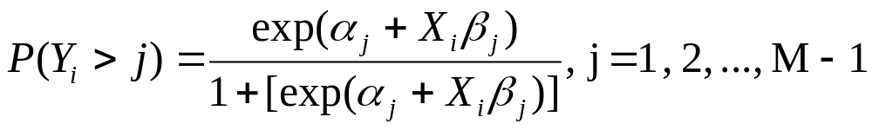
Interpretation of the gologit/gologit2 model
Note that the gologit results are very similar to what we got with the series of binary logistic regressions and can be interpreted the same way.
The gologit model can be written as

Slide 51
gologit2/ partial proportional odds
Either mlogit (fully categorical) or the original gologit can be overkill – both generate many more parameters than ologit does.
gologit2, with the autofit option, will only relax the parallel lines constraint for those variables where it is violated
Note with gologit2 (auto lrforce), if parallel regression holds, both columns will be EXACTLY the same by constraint

Slide 52
Example (no violations)
. gologit2 economy_better female age_d3 education income_d6 i.race party, auto lrforce
------------------------------------------------------------------------------
Testing parallel lines assumption using the .05 level of significance...
Step 1: Constraints for parallel lines imposed for party (P Value = 0.9077)
Step 2: Constraints for parallel lines imposed for 4.race (P Value = 0.5797)
Step 3: Constraints for parallel lines imposed for education (P Value = 0.5671)
Step 4: Constraints for parallel lines imposed for 2.race (P Value = 0.5482)
Step 5: Constraints for parallel lines imposed for female (P Value = 0.4739)
Step 6: Constraints for parallel lines imposed for age_d3 (P Value = 0.3828)
Step 7: Constraints for parallel lines imposed for income_d6 (P Value = 0.0973)
Step 8: Constraints for parallel lines imposed for 3.race (P Value = 0.0936)
Step 9: All explanatory variables meet the pl assumption
Wald test of parallel lines assumption for the final model:
( 1) [0]party - [1]party = 0
( 2) [0]2.race - [1]2.race = 0
( 3) [0]3.race - [1]3.race = 0
( 4) [0]4.race - [1]4.race = 0
( 5) [0]education - [1]education = 0
( 6) [0]female - [1]female = 0
( 7) [0]age_d3 - [1]age_d3 = 0
( 8) [0]income_d6 - [1]income_d6 = 0

Slide 53
------------------------------------------------------------------------------
economy_be~r | Coef. Std. Err. z P>|z| [95% Conf. Interval]
-------------+----------------------------------------------------------------
0 |
female | -.1559337 .1320292 -1.18 0.238 -.4147062 .1028388
age_d3 | .0092311 .02206 0.42 0.676 -.0340057 .0524678
education | .1096631 .0467115 2.35 0.019 .0181102 .201216
income_d6 | .0420399 .0249484 1.69 0.092 -.0068581 .0909379
|
race |
2 | .3031605 .3021777 1.00 0.316 -.289097 .895418
3 | .3377154 .3048791 1.11 0.268 -.2598366 .9352674
4 | -.1192287 .264356 -0.45 0.652 -.6373569 .3988995
|
party | -.3462757 .0419618 -8.25 0.000 -.4285193 -.2640322
_cons | .8468274 .2941817 2.88 0.004 .2702417 1.423413
-------------+----------------------------------------------------------------
1 |
female | -.1559337 .1320292 -1.18 0.238 -.4147062 .1028388
age_d3 | .0092311 .02206 0.42 0.676 -.0340057 .0524678
education | .1096631 .0467115 2.35 0.019 .0181102 .201216
income_d6 | .0420399 .0249484 1.69 0.092 -.0068581 .0909379
|
race |
2 | .3031605 .3021777 1.00 0.316 -.289097 .895418
3 | .3377154 .3048791 1.11 0.268 -.2598366 .9352674
4 | -.1192287 .264356 -0.45 0.652 -.6373569 .3988995
|
party | -.3462757 .0419618 -8.25 0.000 -.4285193 -.2640322
_cons | -1.384699 .2979581 -4.65 0.000 -1.968686 -.8007119
------------------------------------------------------------------------------
.

Slide 54
gologit2 with autofit-back to Williams’ example
. gologit2 warm yr89 male white age ed prst, auto lrforce
--------------------------------------------------------------------------
Testing parallel lines assumption using the .05 level of significance...
Step 1: white meets the pl assumption (P Value = 0.7136)
Step 2: ed meets the pl assumption (P Value = 0.1589)
Step 3: prst meets the pl assumption (P Value = 0.2046)
Step 4: age meets the pl assumption (P Value = 0.0743)
Step 5: The following variables do not meet the pl assumption:
yr89 (P Value = 0.00093)
male (P Value = 0.00002)
If you re-estimate this exact same model with gologit2, instead
of autofit you can save time by using the parameter
pl(white ed prst age)
gologit2 is going through a stepwise process here. Initially no variables are constrained to have proportional effects. Then Wald tests are done. Variables which pass the tests (i.e. variables whose effects do not significantly differ across equations) have proportionality constraints imposed.

Slide 55
------------------------------------------------------------------------------
Generalized Ordered Logit Estimates Number of obs = 2293
LR chi2(10) = 338.30
Prob > chi2 = 0.0000
Log likelihood = -2826.6182 Pseudo R2 = 0.0565
( 1) [SD]white - [D]white = 0
( 2) [SD]ed - [D]ed = 0
( 3) [SD]prst - [D]prst = 0
( 4) [SD]age - [D]age = 0
( 5) [D]white - [A]white = 0
( 6) [D]ed - [A]ed = 0
( 7) [D]prst - [A]prst = 0
( 8) [D]age - [A]age = 0
Internally, gologit2 is generating several constraints on the parameters. The variables listed above are being constrained to have their effects meet the proportional odds/ parallel lines assumptions
Note: with ologit, there were 6 degrees of freedom; with gologit & mlogit there were 18; and with gologit2 using autofit there are 10. The 8 d.f. difference is due to the 8 constraints above.

Slide 56
------------------------------------------------------------------------------
warm | Coef. Std. Err. z P>|z| [95% Conf. Interval]
-------------+----------------------------------------------------------------
SD |
yr89 | .98368 .1530091 6.43 0.000 .6837876 1.283572
male | -.3328209 .1275129 -2.61 0.009 -.5827417 -.0829002
white | -.3832583 .1184635 -3.24 0.001 -.6154424 -.1510742
age | -.0216325 .0024751 -8.74 0.000 -.0264835 -.0167814
ed | .0670703 .0161311 4.16 0.000 .0354539 .0986866
prst | .0059146 .0033158 1.78 0.074 -.0005843 .0124135
_cons | 2.12173 .2467146 8.60 0.000 1.638178 2.605282
-------------+----------------------------------------------------------------
D |
yr89 | .534369 .0913937 5.85 0.000 .3552406 .7134974
male | -.6932772 .0885898 -7.83 0.000 -.8669099 -.5196444
white | -.3832583 .1184635 -3.24 0.001 -.6154424 -.1510742
age | -.0216325 .0024751 -8.74 0.000 -.0264835 -.0167814
ed | .0670703 .0161311 4.16 0.000 .0354539 .0986866
prst | .0059146 .0033158 1.78 0.074 -.0005843 .0124135
_cons | .6021625 .2358361 2.55 0.011 .1399323 1.064393
-------------+----------------------------------------------------------------
A |
yr89 | .3258098 .1125481 2.89 0.004 .1052197 .5464
male | -1.097615 .1214597 -9.04 0.000 -1.335671 -.8595579
white | -.3832583 .1184635 -3.24 0.001 -.6154424 -.1510742
age | -.0216325 .0024751 -8.74 0.000 -.0264835 -.0167814
ed | .0670703 .0161311 4.16 0.000 .0354539 .0986866
prst | .0059146 .0033158 1.78 0.074 -.0005843 .0124135
_cons | -1.048137 .2393568 -4.38 0.000 -1.517268 -.5790061
------------------------------------------------------------------------------
At first glance, it appears there are just as many parameters as before – but 8 of them are duplicates because of the proportionality constraints that have been imposed.
.

Slide 57
------------------------------------------------------------------------------
warm | Coef. Std. Err. z P>|z| [95% Conf. Interval]
-------------+----------------------------------------------------------------
SD |
yr89 | .98368 .1530091 6.43 0.000 .6837876 1.283572
male | -.3328209 .1275129 -2.61 0.009 -.5827417 -.0829002
white | -.3832583 .1184635 -3.24 0.001 -.6154424 -.1510742
age | -.0216325 .0024751 -8.74 0.000 -.0264835 -.0167814
ed | .0670703 .0161311 4.16 0.000 .0354539 .0986866
prst | .0059146 .0033158 1.78 0.074 -.0005843 .0124135
_cons | 2.12173 .2467146 8.60 0.000 1.638178 2.605282
-------------+----------------------------------------------------------------
D |
yr89 | .534369 .0913937 5.85 0.000 .3552406 .7134974
male | -.6932772 .0885898 -7.83 0.000 -.8669099 -.5196444
white | -.3832583 .1184635 -3.24 0.001 -.6154424 -.1510742
age | -.0216325 .0024751 -8.74 0.000 -.0264835 -.0167814
ed | .0670703 .0161311 4.16 0.000 .0354539 .0986866
prst | .0059146 .0033158 1.78 0.074 -.0005843 .0124135
_cons | .6021625 .2358361 2.55 0.011 .1399323 1.064393
-------------+----------------------------------------------------------------
A |
yr89 | .3258098 .1125481 2.89 0.004 .1052197 .5464
male | -1.097615 .1214597 -9.04 0.000 -1.335671 -.8595579
white | -.3832583 .1184635 -3.24 0.001 -.6154424 -.1510742
age | -.0216325 .0024751 -8.74 0.000 -.0264835 -.0167814
ed | .0670703 .0161311 4.16 0.000 .0354539 .0986866
prst | .0059146 .0033158 1.78 0.074 -.0005843 .0124135
_cons | -1.048137 .2393568 -4.38 0.000 -1.517268 -.5790061
------------------------------------------------------------------------------
At first glance, it appears there are just as many parameters as before – but 9 of them are duplicates because of the proportionality constraints that have been imposed.
.

Slide 58
Interpretation of the gologit2 results
Effects of the constrained variables (white, age, ed, prst) can be interpreted pretty much the same as they were in the earlier ologit model.
For yr89 and male, the differences from before are largely a matter of degree. People became more supportive of working mothers across time, but the greatest effect of time was to push people away from the most extremely negative attitudes. For gender, men were less supportive of working mothers than were women, but they were especially unlikely to have strongly favorable attitudes.

Slide 59
Heteroskedasticity
Just as with binary logit/probit, we assume a constant variance
Heteroskedasticity results in bias
Heteroskedastic ordered logit/probit
Richards calls this Ordinal Generalized Linear Models (oglm)
  “net serach oglm”
  Be sure to cite him…
Just as before, need to specify the source of the heteroskedasticity

Slide 60
. xi: oglm economy_better female age_d3 education income_d6 i.race party, het(income_d6)
--------------------------------------------------------------------------------
economy_better | Coef. Std. Err. z P>|z| [95% Conf. Interval]
---------------+----------------------------------------------------------------
economy_better |
female | -.1428856 .1130909 -1.26 0.206 -.3645397 .0787685
age_d3 | .0068739 .0192114 0.36 0.720 -.0307798 .0445276
education | .0998706 .0402138 2.48 0.013 .021053 .1786882
income_d6 | .0404309 .0218161 1.85 0.064 -.0023279 .0831897
_Irace_2 | .2748471 .2668204 1.03 0.303 -.2481113 .7978055
_Irace_3 | .298994 .2640876 1.13 0.258 -.2186082 .8165962
_Irace_4 | -.1264995 .226936 -0.56 0.577 -.5712858 .3182869
party | -.3005591 .041709 -7.21 0.000 -.3823072 -.218811
---------------+----------------------------------------------------------------
lnsigma |
income_d6 | -.0322986 .0153005 -2.11 0.035 -.062287 -.0023101
---------------+----------------------------------------------------------------
/cut1 | -.7022645 .2663229 -2.64 0.008 -1.224248 -.1802812
/cut2 | 1.215377 .2708539 4.49 0.000 .6845132 1.746241
--------------------------------------------------------------------------------

Slide 61
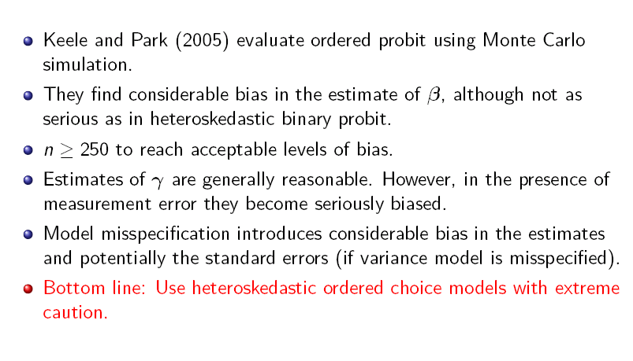
From Steenbergen:

Slide 62
Caveat: Utilities model works with choices but not progression
  For example: Cannot model assistant-associate-full as a simple ordered variable because nearly all associates have to be assistants first.
  Instead use a continuation ratio model
  Seqlogit (described in Long and Freeze)
  For a simple example of how to use this kind of data, see http://opencommons.uconn.edu/cgi/viewcontent.cgi?article=1034&context=nera_2010

